Slide 1
Electronic Twister
Team PYRE
Pooya Khorrami, Yush Gupta, Ross Finman, Evan Mullinix

Slide 2
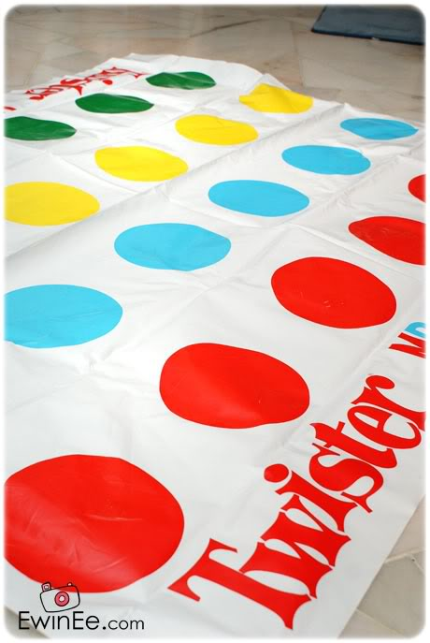
Concept & Motivation
Concept
Electronic Twister game
Lighted panel locations change
Changes occur quicker
Moves in sync with music
Motivation
Fun, dynamic, & entertaining
Versatile design
DDR
Notes:
We are doing an electronic variation of the classic twister game
We have a 4x4 grid of pads with four different colors
The object of the game is to stay on your color as they randomly shift around
Pads fade colors four at a time
Motivation
Twister is already popular, but it is played out.
Our project creates an interactive game that everyone can play
Lots of flashing lights
May options available, could add break dancing like DDR or be a party

Slide 3
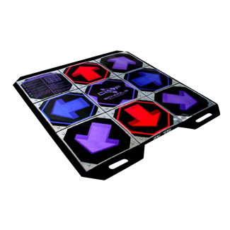
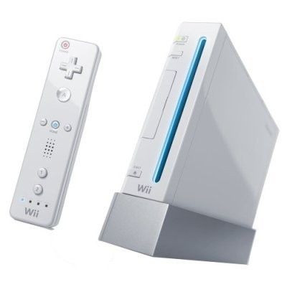
Competitive Analysis
Twister
Vendors: Toy stores
Price: $15
Conception: 1966
DDR
Vendors: Toy stores
Price: $15 - $30
Conception: 1998
Wii
Vendors: Toy/Game stores
Price: $199
Conception: 2006
Electronic Twister
Vendors: Toy stores
Price: ~$150
Conception: Yesterday

Slide 4
Requirements
Game shall start when start button pressed
Game shall change dots progressively faster
Game shall indicate variable “grace time” between color changes with blinking dots
Game shall detect when player loses
LEDs shall flash no less than 4 different colors
Mat shall be able to be seen clearly in lit room.
Mat shall detect when >1 lbs is anywhere on dot
Mat shall be powered by AC wall adaptor
Mat lights should sync to music when idle
Mat should be <1/2 inches thick when flat

Slide 5
Technical Specifications
5*16 multi-color LEDs
17 contact switches
1 Arduino micocontroller
1 headphone/iPod jack
1 speaker output connector

